Slide 1
SOC 374
UNIT-1
(INSTRUCTOR)
DR. SUDHA DUBEY
ASSISTANT PROFESSOR (SOCIOLOGY)

Slide 2
TOPICS TO BE STUDIED
Understanding Criminology: Introduction : Definition and Scope, Brief history of Criminology,
Criminology and Other Social Sciences

Slide 3
Unit 1
Criminology is the scientific, interdisciplinary study of crime and deviant behavior, drawing on fields such as sociology, psychology, and law to understand its causes, control, and prevention.
Definition and Scope
Criminology is defined as the body of knowledge regarding crime as a social phenomenon, including within its scope the processes of making laws, breaking laws, and reacting toward the breaking of laws. The field is empirical and theoretical, using the scientific method to collect and analyze data to test theories and inform real-world policy.

Slide 4
Unit 1
DEFINITION OF CRIME:
The legal meaning of crime is an act or omission punishable by law. Crime is an act which is forbidden by law and revolting to the moral sentiments of the society.
1. SIR WILLIAM BLACKSTONE:
Crime is a violation of the public right and duties due to the whole community, considered as a community.
2. STEPHEN:
A crime is an act or omission in respect of which legal punishment may be inflicted on the person who is in default, either by acting or omitting to act.

Slide 5
Unit 1
DEFINITION OF CRIMINOLOGY: Criminology is, in general, the scientific study of crime and its cure/treatment. The scientific study of crime and its cure involves the study of nature of crime, criminal behaviour, treatment of criminals by way of punishment etc., and prevention of crimes. The criminology is the offshoot of the development in Sociology, Psychology and Psychiatry.
Prof. Sutherland defines criminology as the body of knowledge regarding crime as a social phenomena.

Slide 6
Unit 1
DIFFERENCE BETWEEN CRIME, CRIMINALITY, CRIMINAL AND CRIMINOLOGY:
Crime is something illegal. Crime is the actual act, or the sum of all actual acts. For eg., ”Crime has decreased in Chennai City.”
Criminal is a person who commits crimes.
Criminality is the propensity for criminal activity in a person or criminal activity in a certain area. Criminality is the mental attitude or philosophy which leads a person to commit
crimes.

Slide 7
Unit 1
Nature of criminology:
Characteristics of the Nature of Criminology:
Scientific Method: It systematically examines the causes, consequences, and patterns of criminal behavior, rather than relying on speculation.
Social Science: It views crime as a social creation, focusing on how societal norms, laws, and environmental factors define and influence deviance.
Interdisciplinary: It draws on diverse disciplines, including psychology (criminal motivation), sociology (social structures), law (legal definitions), and biology (bio-criminology).

Slide 8
Unit 1
Nature of criminology:
Applied Science: It goes beyond theory to practical application, aiming to develop methods for crime prevention, control, and rehabilitation.
Dynamic and Flexible: Criminology changes as social conditions and, in turn, the nature of crime, advance.
Nationalistic/Relative: The definition of what constitutes a crime depends on the specific legal system and, therefore, varies by country or jurisdiction.

Slide 9
Unit 1
The History of Criminology:
Criminology truly began in Europe between the late 1700’s and the early 1800’s. Classical school of criminology founders were theorists on crime and punishment development. These people include writers Cesare Beccaria and Jeremy Bentham. Although torture was taking place all over the continent, especially for confessions and testimonies, classical school believed torture to be wrong.
According to the classic school of thought, crimes are committed through free will. People know what they are doing and should be punished.
https://www.youtube.com/watch?v=bjyDQdv6gSk

Slide 10
Unit 1
The History of Criminology:
Those consequences should be strong enough to deter other people from the crime and should be harsher than the criminal gain. They did explain that the criminal justice system drastically needed to be modernized and improved. At that time, criminal justice included painful torture such as stretching, crushing and stabbing of the accused bodies. The classical school aimed to improve the system partly by limiting or eliminating the torture.
It marked the beginning of great progress for the criminal justice system.
https://scholarlycommons.law.northwestern.edu/cgi/viewcontent.cgi?article=4793&context=jclc

Slide 11
Unit 1
In the 1920s, Robert E. Park and Ernest Burgess presented their Chicago school of thought through the University of Chicago. The study related criminology to sociology and provided research on concentric zones, or zones in transition where people tend to be more criminally active than others. Through the addition of Henry McKay and Clifford Shaw’s research specifically on juvenile delinquents, a new social ecology study was developed.
https://www.youtube.com/watch?v=WPBwvwyIcow
The Chicago school of thought determined that crimes tend to be taught by older criminals whom people may be associated with either personally or professionally.

Slide 12
Unit 1
Criminology combines social action data with criminal activity to understand motive and determine appropriate consequences. As such, criminology is necessary for the proper development and execution of criminal justice systems. From the case development to long after the verdict, criminologists are responsible for understanding why criminals do what they do.
Through this information people will be safer, better understood and justly punished for crimes. The ultimate motive behind criminology though, is the prevention of crime.

Slide 13
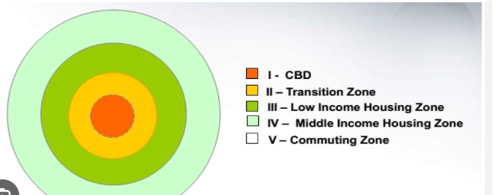
Unit 1
concentric zone:
https://www.youtube.com/watch?v=PFYQSscg3Mg

Slide 14
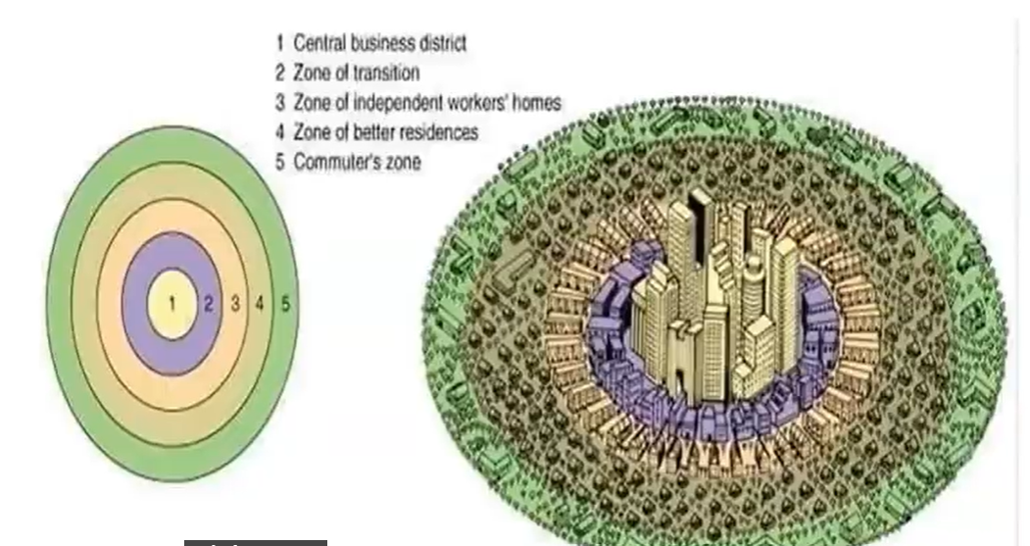
Unit 1

Slide 15
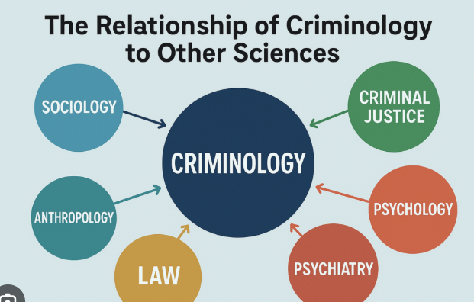
Unit 1
Criminology and Other Social Sciences:
https://www.youtube.com/watch?v=chO4XxqHoUE

Slide 16
Unit 1
Criminology is an interdisciplinary social science that investigates the nature, causes, and control of criminal behavior. It draws heavily from various social science disciplines to provide a comprehensive understanding of crime as a complex social phenomenon.
Interdisciplinary Relationships
Sociology: Historically the "parent" discipline of criminology, sociology provides frameworks like Social Disorganization Theory and Strain Theory to explain how social structures, inequality, and poverty contribute to crime.
https://www.youtube.com/watch?v=0y4yMJtSoJg

Slide 17
Unit 1
Psychology: Focuses on individual-level factors, including cognitive processes, personality traits (e.g., neuroticism), and mental health. Theories like Psychoanalytic Theory explore how unconscious conflicts or early trauma influence deviant behavior.

Slide 18
Unit 1
Economics: Analyzes crime through a cost-benefit lens. Rational Choice Theory posits that individuals commit crimes when perceived benefits outweigh potential risks. It also examines the impact of labor market conditions and income inequality on crime rates.
Political Science: Investigates how political power, institutions, and ideologies shape criminal law and justice policies. It explores how the state uses the legal system for social control and the impact of governance on political stability.

Slide 19
Unit 1
Anthropology: Provides cultural and historical context, studying how different societies define and respond to crime. Anthropological Criminology has historically explored physical or hereditary predispositions to crime, though modern focus centers on cultural norms and symbolic meanings.

